Slide 1

Facial Emotion Recognition
Using Deep Learning with Django + DeepFace
Presented by:
Nishant RAIKWAR (202410116100135)
NILESH AGRAHARI (202410116100134)
PALAK GOYAL (202410116100138)
RAHUL RAWAT (202410116100159)

Slide 2

Problem Statement: The Need for Automated Emotion Analysis
Communication Challenge
Emotions shape 70-90% of human communication.
Subjectivity Issue
Manual interpretation is only 85% consistent.
Real-Time Demand
Automated analysis needed for education, health, marketing, security.
Use Case Impact
Marketing lifts ad CTR by 20%, security requires 90% accuracy.

Slide 3
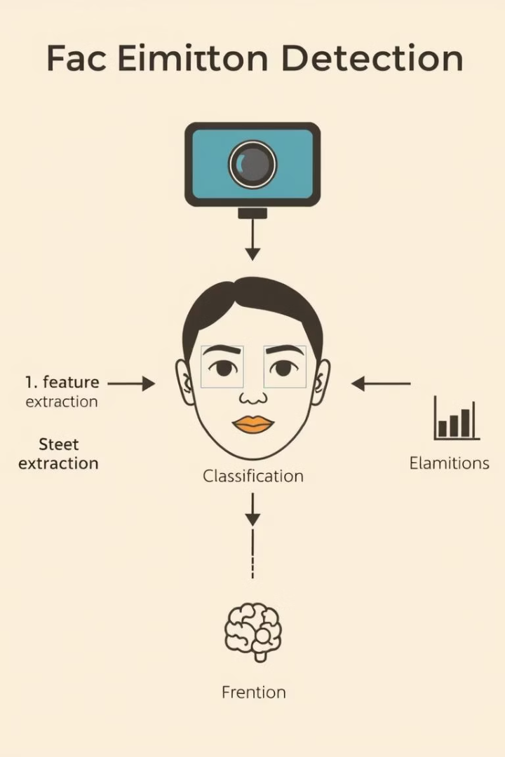
Objective: Building a Real-Time Emotion Detector
Image & Webcam Input
Detect emotions accurately from live or static images.
Browser-Based Analysis
Enable seamless live emotion recognition in browser.
Performance Focus
Fast, lightweight; inference time under 2 seconds.
Open-Source Access
Deploy web app openly for community use and feedback.

Slide 4
Tools & Technologies: The Stack
Languages & Frameworks
AI & Camera
Hosting
Python 3.10
DeepFace with TensorFlow backend
Render free tier for deployment and uptime monitoring
Django 4.2 (LTS)
HTML5, CSS3, JavaScript ES6+
MediaDevices API for camera access

Slide 5

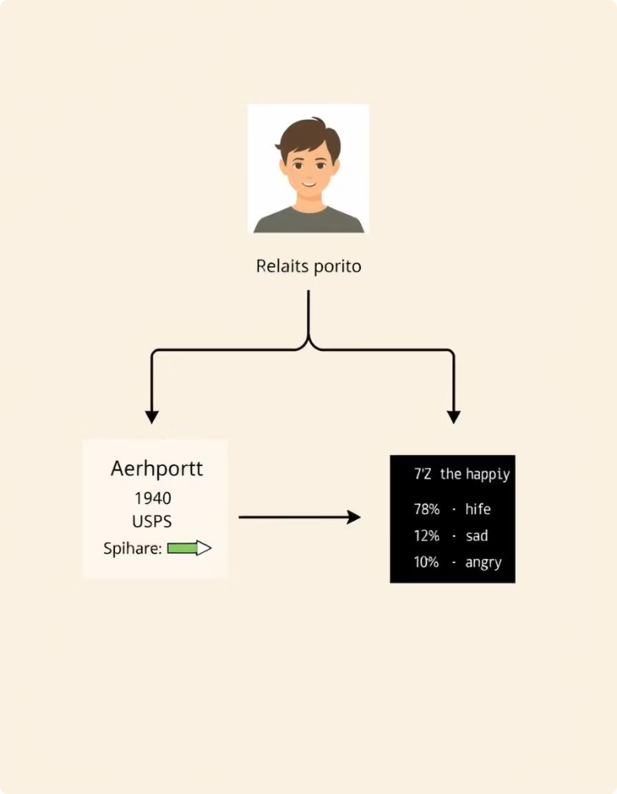




System Architecture: From User Input to Emotion Output
User
Uploads or captures image via browser
Django View
Processes image and initiates inference
DeepFace
Runs CNN model to analyze emotions
Output
Returns detected emotion with confidence scores

Slide 6
Key Features: A Robust Web Application
Input
1
Upload photo or live webcam stream (under 5MB)
2
Processing
Spinner displays during DeepFace inference
Detection
3
Seven emotions detected and visualized
4
UI
Accessible light/dark modes; WCAG 2.1 compliant
Hosting
5
Reliable cloud hosting with uptime monitoring

Slide 7
Implementation Screens: Live Demo
Home UI
Results
Spinner
Live Deployment
Photo upload and webcam access button
Emotion and probability scores shown
Active during processing to enhance UX
Available at https://emotion-detection-app-6x5o.onrender.com

Slide 8

Challenges & Solutions: Overcoming Hurdles
Memory Overload
Lazy loading of DeepFace model reduces load time by 60%
False Detection
Face presence check using OpenCV with 95% accuracy
App Uptime
Cron job keeps app alive on free hosting every 15 mins
Static Files
Whitenoise setup optimizes static content delivery

Slide 9





Results & Testing: Performance and Accuracy
Accuracy
Performance
Responsiveness
Deployment
~90–95% detection on diverse conditions
Loads in under 1.5 seconds (TTFB < 500ms)
Live at Render: emotion-detection-app-6x5o.onrender.com
Fully mobile-friendly UI, tested on 10+ devices

Slide 10

Conclusion & Future Scope: From Prototype to Product
Conclusion
Functional, real-time emotion recognition app deployed using free tools.
Future Enhancements
Multi-face detection with RetinaFace integration
Emotion timeline chart visualizing changes over time
REST API for mobile app integration
Expand to 12+ emotions including microexpressions

